Slide 1


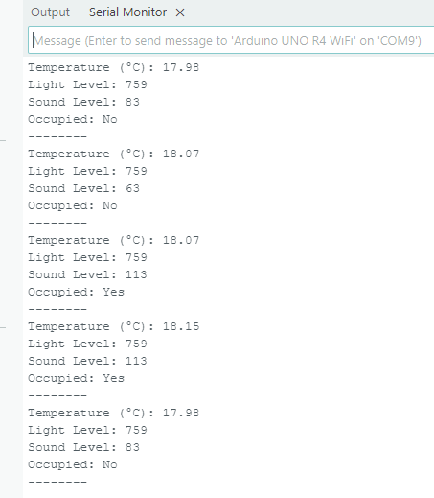
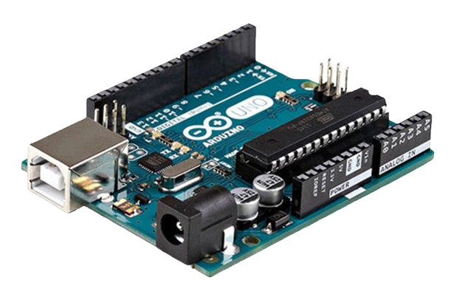
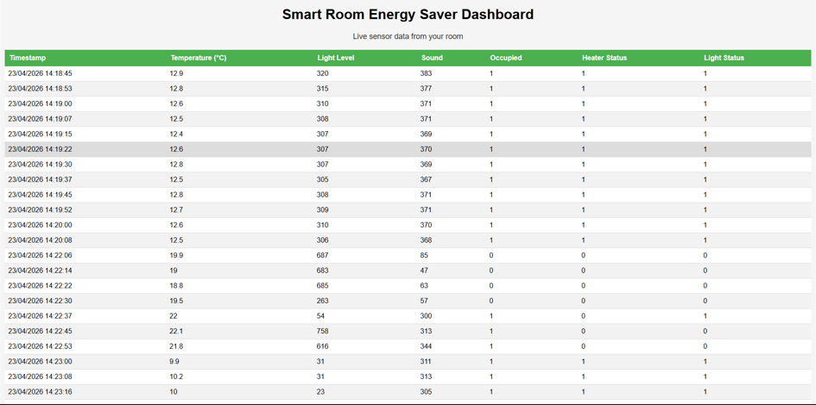
SMART ROOM ENERGY SAVER
Introduction / Objective
With our Internet of Things project, we set out to tackle sustainable development goals 7 & 13, with a way to save energy in the average household. To do this we used our Arduinos to monitor a room to see if it was occupied and respond accordingly by turning off the lights to save energy.
By James O' Sullivan, Eanna Gallagher and Dede Coughlan
Methods
Results
Conclusion
To achieve our objective, we used several of the sensors that the Arduino kits supplied us with, including the temperature, light, and sound sensors, as well as the LED and relay.
We used our code to read the sensors and detect whether the room was occupied or not based on sound levels and the rooms temperature to then activate the LED, mimicking a light switch in a room.
With our code, we managed to get the Arduino to read the occupancy of a room to then respond accordingly.
Our code works as intended and gives us the expected output when ran, allowing for us to succeed in our objective
Output
Temperature
Sound levels
Light levels
LED output
Occupancy
Image of output code
/
/
/
Discussion
We have managed to successfully get the Arduino to read the inputs and respond to them, achieving our initial goal, we have also set up a website that can display the outputs in real time, as well as Wifi integration and security

